Slide 1

Wavecon Telecom – 5G Launch Impact Analysis
Tool Used: Power BI
PRESENTED BY
Saranya K P

Slide 2
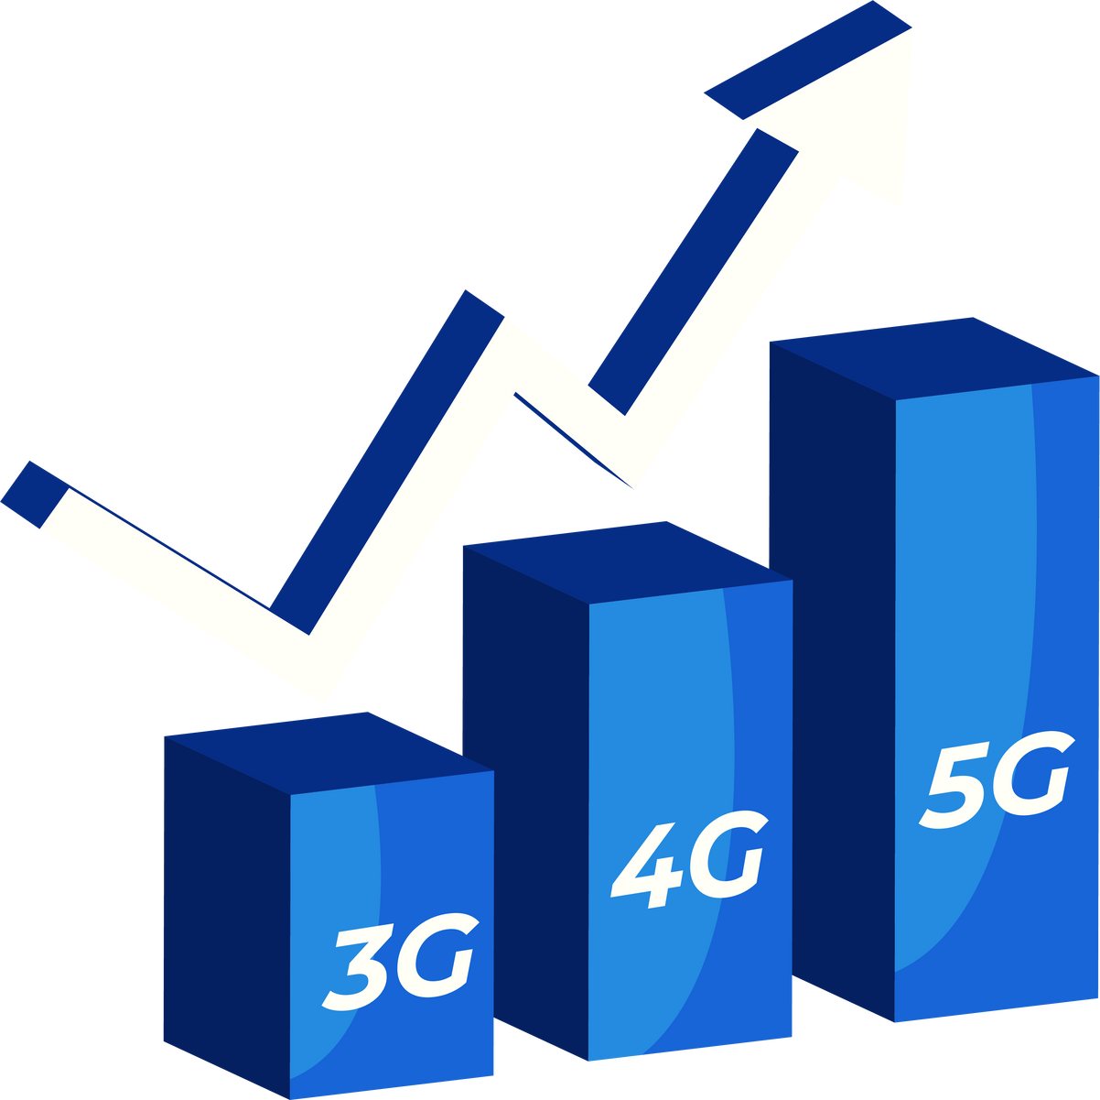
Understanding the Need for 5G Impact Analysis
Wavecon recently launched its 5G services with the expectation of driving higher customer adoption, increasing revenue, and strengthening its overall market position.
However, early performance indicators show mixed results — including a slight decline in revenue, a drop in active users, and a notable increase in customer churn.
To accurately understand the impact of the 5G rollout, we conducted a detailed analysis of key business KPIs before and after the launch. This presentation provides a data-driven view of how 5G has influenced user behavior, revenue patterns, plan performance, and city-level adoption.

Slide 3


Business Purpose of the Dashboard
The goal of this dashboard is to present a clear and comprehensive view of the business impact following the 5G launch. It outlines how customer behavior, revenue performance, and city-level adoption have shifted after the rollout. The dashboard highlights the plans that are performing strongly as well as those that may require strategic attention. It also brings visibility to early indicators of churn and emerging competitive pressures. Overall, the dashboard serves as a decision-support tool, enabling a clearer understanding of post-5G performance and areas where improvement or strategic adjustments may be necessary.

Slide 4

Agenda
Assess the revenue impact of the 5G launch
Identify KPIs that show decline or underperformance post-5G
Review plan-wise performance to highlight strong and weak contributors
Evaluate plans significantly affected by the 5G rollout and determine continuation or discontinuation needs
Analyze discontinued plans and understand the factors behind their phase-out
Insights Summary
How This Analysis Enables Strategic Improvement
Recommendations

Slide 5
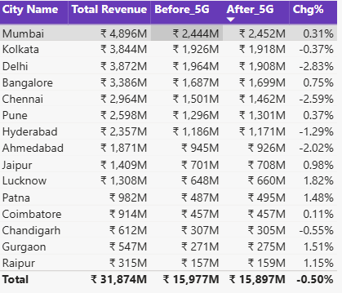
Revenue Impact of 5G Launch
₹ 4.0bn
₹ 16.0bn
₹ 15.9bn
₹ -0.50%
Monthly Average
Before 5G
After 5G
Chg %
  There was a slight decline of –0.50% after the 5G launch.
  Significant declines observed in major cities: Delhi (–2.83%), Hyderabad (–1.29%), Ahmedabad (–1.09%), and Chennai (–1.09%).
  Strong growth in Lucknow(+1.82%), Gurgaon (+1.51%), Raipur (+1.15%), Patna (+1.48%), and Jaipur (+0.98%).
  Major metros like Mumbai, Delhi, and Kolkata contribute the highest revenue, while cities such as Raipur, Gurgaon, and Chandigarh contribute the least.

Slide 6
Most Underperforming KPI After the 5G Launch
1.6M
5.6M
7.0M
23.50%
Monthly Average
Before 5G
After 5G
Chg %
  Unsubscribed Users (TuSU) is the most underperforming KPI post-5G.
  Unsubscribed users increased significantly after 5G, rising from 5.6M to 7.0M (+23.50%).
  This is the largest negative change across all KPIs.
  Extremely high churn is observed in Lucknow (+77.91%), Pune (+55.30%), Jaipur (+52.47%), and Chandigarh (+45.63%).
  Mumbai (–12.63%) is the only city to record a decline in churn.
  The overall upward trend in churn indicates customer dissatisfaction or competitive switching following the 5G rollout.

Slide 7
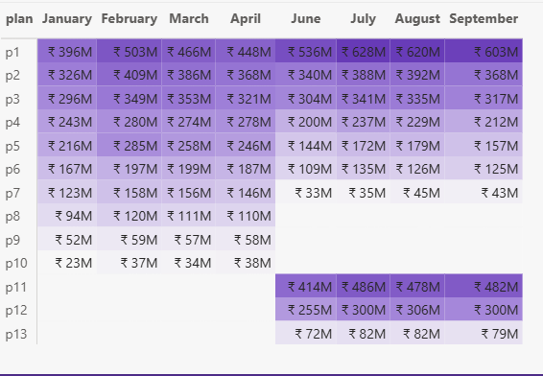
Plan-Wise Revenue Analysis
Plans Performing Well After the 5G Launch
  p1, p2, and p3 show strong revenue performance with consistent monthly growth.
  p1 leads overall with the highest post-5G revenue (₹2.4bn).
  p11 also performs well with noticeable spikes in monthly revenue after the 5G rollout.
  These plans benefit from higher data usage and customer upgrades to 5G-ready offerings.
Plans Not Performing Well After the 5G Launch
  p4, p5, and p6 show moderate but declining or stagnant revenue trends after 5G.
  Lower-revenue plans such as p7, and p13 remain weak with minimal contribution.
  Plans p9, p10, and p13 are the poorest performers, showing consistently low monthly values.
  These underperforming plans may require redesign, repositioning, or discontinuation.

Slide 8
Assessing 5G-Impacted Plans for Continuation, Redesign, or Phase-Out
Plan Recommended for Discontinuation
  p7 shows the sharpest decline after 5G, with revenue dropping across months compared to the pre-5G period.
  Its monthly trend falls consistently and remains one of the lowest-performing plans post-5G.
Plans to Redesign or Reposition
  P4 and p13 show moderate but inconsistent performance, contributing mid-level revenue but failing to show any positive month-over-month growth after 5G.
  These plans retain active users but lack competitiveness compared to higher-performing 5G-friendly plans.
Plans to Redesign, Test, and Evaluate (Trial Period)
  p5 and p6 (mid-tier plans) show stable but flat performance, with revenue hovering at the lower-middle range post-5G. Recommend redesigning or repositioning and testing performance for 2–3 months.
  If redesigned versions show positive revenue movement during the test period, they can be continued. If no improvement is seen, these plans should be phased out to avoid portfolio inefficiency.

Slide 9
Plans Discontinued After the 5G Launch
  Plans p8, p9, and p10 were discontinued post-5G, as they show near-zero monthly revenue and minimal user activity in the dashboard.
  These plans contribute less than 5% to total plan revenue after 5G, indicating very limited adoption.
  p8, p9, and p10 were probably built for 4G usage patterns, offering lower data benefits and outdated pricing structures.
  Their features did not align with 5G customer requirements, resulting in rapid customer migration toward higher-value 5G-friendly plans.
  Due to consistently low performance, these plans became operationally irrelevant, making discontinuation the most appropriate decision.

Slide 10

Insights Summary
  Revenue slightly declined (–0.50%) after the 5G rollout, indicating the launch did not translate into immediate revenue uplift.
  ARPU increased significantly (+11.05%), showing customers are willing to spend more on higher-value 5G plans.
  Total Active Users declined (–8.28%), revealing reduced engagement and possible customer migration to competitors.
  Churn surged sharply post-5G (+23.50%), signaling dissatisfaction in key markets and highlighting retention risks.

Slide 11
How This Analysis Enables Strategic Improvement
  Helps identify the key drivers of churn and user decline, enabling targeted retention actions that can reduce churn by 5–10%.
  Highlights high-potential cities and customer segments, allowing smarter resource allocation that can boost revenue by 2–4%.
  Supports redesign of mid-performing plans, improving product alignment and potentially increasing plan adoption by 10–15%.
  Provides insights to refine premium offerings, helping leverage ARPU growth and increase ARPU by an additional 5%.
  Improves strategic forecasting and decision-making, enabling timely actions that can enhance overall 5G performance and customer satisfaction.

Slide 12
Recommendations
  Strengthen customer retention programs to reduce rising churn, focusing on high-churn cities, especially Lucknow and Pune.
  Redesign and relaunch mid-performing plans (p4, p5, p12, p13) to better align with 5G usage patterns and customer expectations.
  Invest in top-performing cities to maximize revenue growth and reinforce market leadership.
  Improve network quality and customer experience in underperforming cities to boost active users and reduce customer migration.

Slide 13
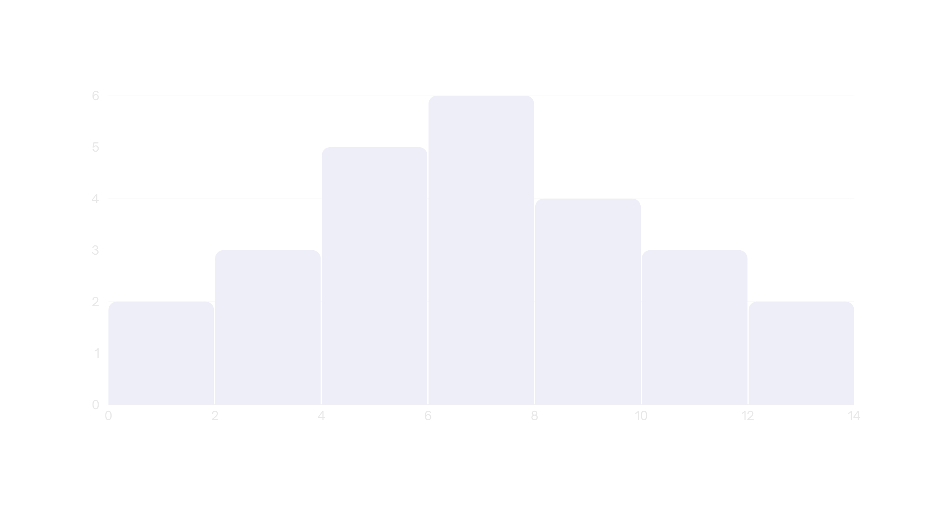
Thank You

